Slide 1

Integrated Retail Sales Performance Tracking and Analysis
TCS RIO – Industry Project
Kaushik Upadhyay
30892
Yenepoya (Deemed to be University)

Slide 2
Project Objective
To design an integrated retail sales performance analysis system that tracks key business KPIs, identifies sales trends over time, evaluates product category performance, and analyzes customer demographics using interactive data visualizations to support data-driven decision-making.

Slide 3
Dataset Overview
The dataset consists of 1,000 retail transaction records capturing customer purchases across multiple product categories over a defined time period. The data has been cleaned and enriched to support effective analysis of sales performance, customer behavior, and temporal trends.
The dataset was cleaned to remove inconsistencies and ensure accurate analysis.
Derived columns such as Age Group, Month, Day of Week, and Quarter were created to enable time-based and demographic analysis.
All numerical fields were validated for correctness and consistency.
This dataset enables us in monitoring overall sales performance, identifying sales trends over time, analysing product category contributions, and understanding customer demographics and purchasing behavior.

Slide 4
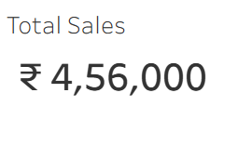
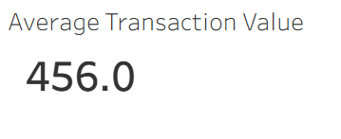
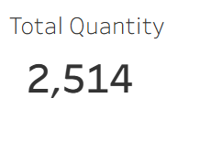
KPI Summary
The KPI summary provides a high-level overview of the overall retail sales performance. These metrics help stakeholders quickly assess business health and identify trends without analyzing detailed transaction-level data.
Total Sales (₹4,56,000):
Represents the cumulative revenue generated from all retail transactions during the analysis period. This KPI indicates the overall financial performance of the business.
Average Transaction Value (₹456):
Measures the average revenue generated per transaction. This helps evaluate customer spending behavior and indicates the effectiveness of pricing and upselling strategies.
Total Quantity Sold (2,514 units):
Reflects the total number of products sold across all categories. This metric provides insight into sales volume and product demand.

Slide 5
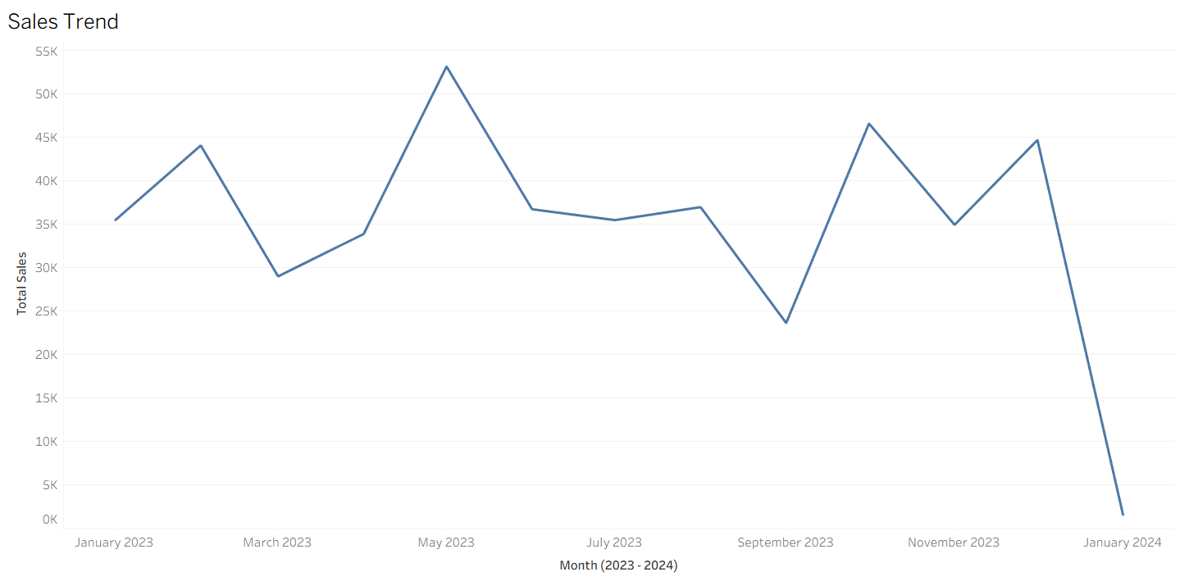
Sales Trend Analysis
Sales show fluctuations with a peak in mid-2023 and a decline in early 2024.

Slide 6
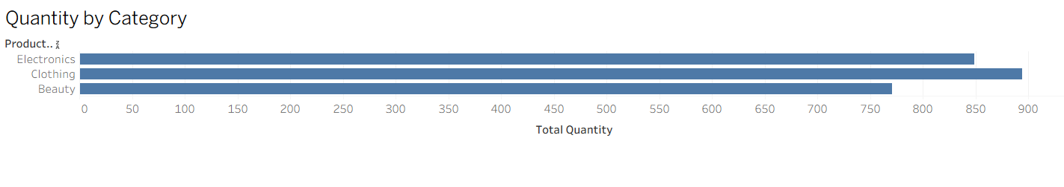
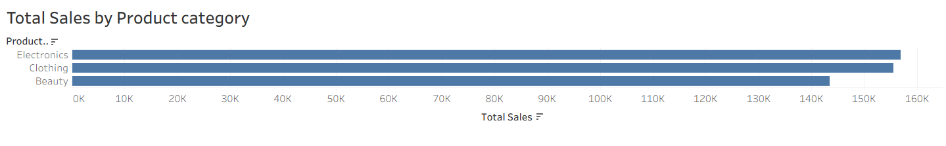
Product Category Analysis
Electronics contributes the highest revenue, driven by higher-priced items, while Clothing leads in sales volume due to frequent purchases. Beauty products show lower performance, indicating potential scope for targeted promotions.

Slide 7
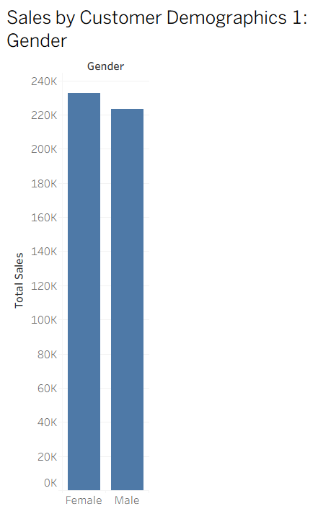
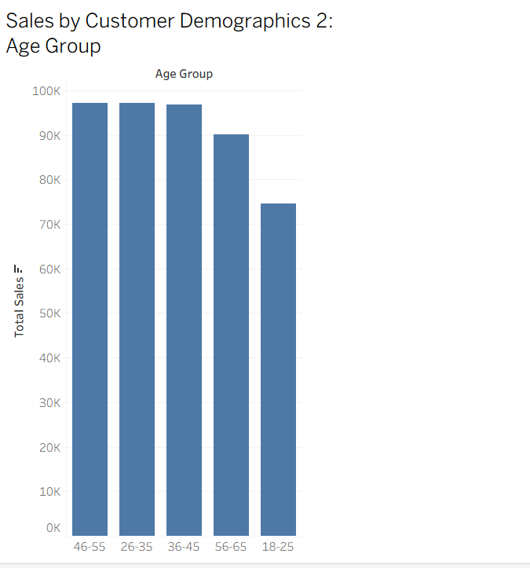
Customer Demographics Analysis
Female customers contribute slightly higher sales, while the 26–45 age group represents the most significant revenue segment. These insights support targeted marketing and customer segmentation strategies.

Slide 8
Key insights & inference
Key Insights
Overall sales performance shows consistent revenue generation, supported by balanced contributions from multiple product categories and customer segments.
Electronics drives the highest revenue due to higher unit prices, while Clothing contributes significantly through higher sales volume, indicating two distinct revenue drivers.
Female customers and the 26–45 age group emerge as the most valuable customer segments, accounting for a substantial share of total sales.
Sales trends reveal periodic fluctuations, suggesting the influence of seasonality and customer purchasing cycles.

Slide 9
Inference
Revenue growth can be optimized by maintaining premium product availability in high-performing categories like Electronics while leveraging volume-driven categories such as Clothing for consistent cash flow.
Targeted marketing efforts focused on high-value customer segments (female customers and the 26–45 age group) can improve customer engagement and sales conversion.
Seasonal trend patterns highlight the need for data-driven inventory planning and promotional timing to minimize revenue dips and maximize peak-period performance.
The integrated dashboard enables stakeholders to quickly monitor KPIs, identify trends, and make informed business decisions, demonstrating the value of data visualization in retail analytics.

Slide 10
Conclusion & Business Value
Business Value
Improved Decision-Making:
The dashboard enables stakeholders to quickly assess business performance through key KPIs, reducing dependency on manual reporting.
Customer Segmentation Insights:
Identifying high-value customer segments supports targeted marketing strategies and improved customer engagement.
Product Performance Optimization:
Insights into category-level performance help optimize inventory planning, pricing strategies, and promotional campaigns.
Operational Efficiency:
Automated and interactive visual reporting saves time and ensures consistent access to up-to-date business insights.
Scalability:
The analytical framework can be extended to incorporate real-time data, predictive analytics, and advanced customer segmentation in future implementations.

